Slide 1
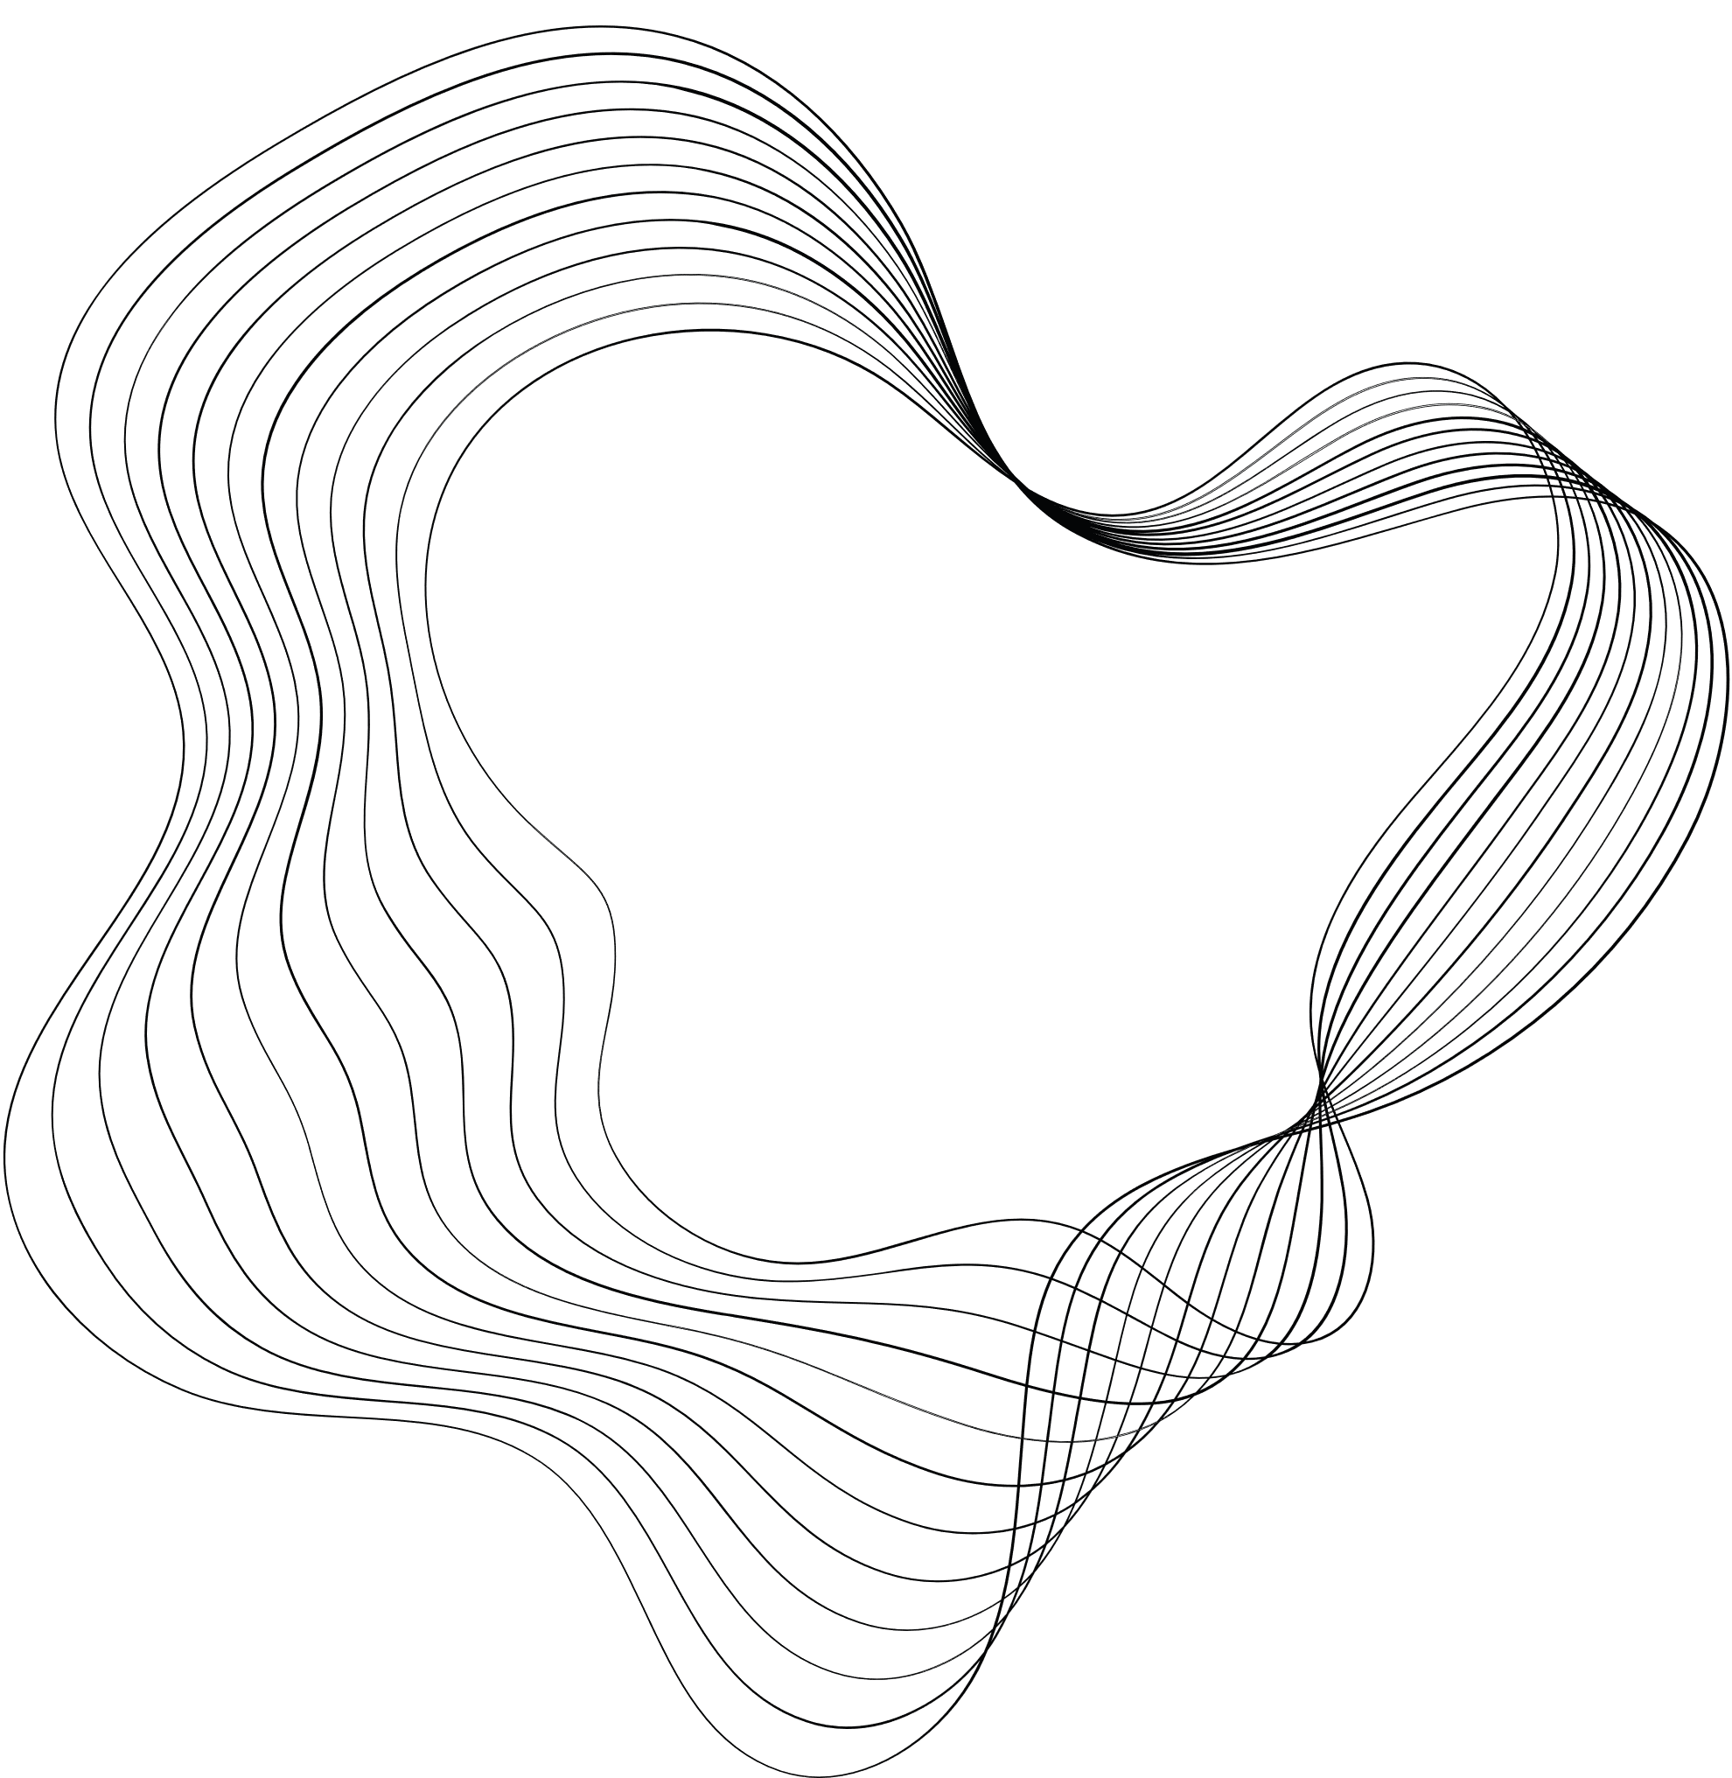

PROJECT-4
PANDEMIC PULSE
TUSHAR SHINDE
21BTRCL114
AIML-B

Slide 2
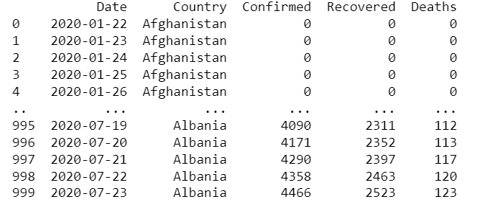
INTRODUCTION
Structure of the Dataset
Date: Date of the recorded data (datetime format)
Country: Country name (string)
Confirmed: Cumulative number of confirmed COVID-19 cases (integer)
Deaths: Cumulative number of COVID-19 related deaths (integer)
Recovered: Cumulative number of recovered COVID-19 cases (integer)

Slide 3

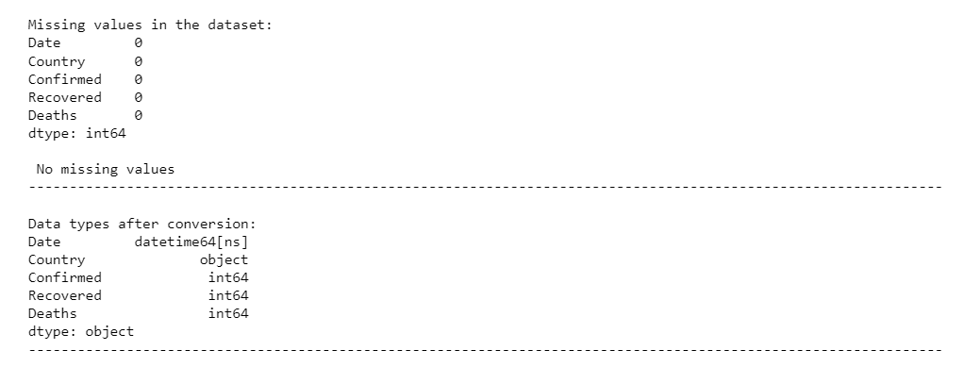
PREPROCESSING

Slide 4
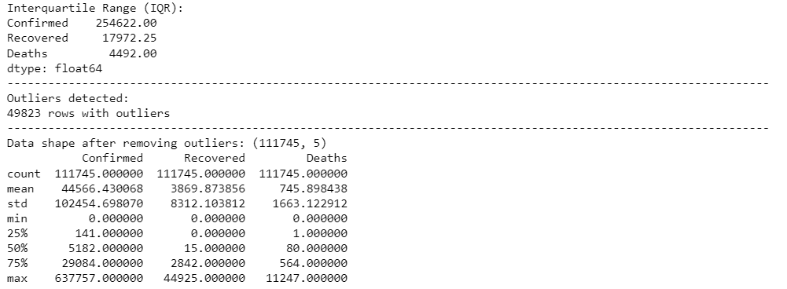
CLEANING

Slide 5

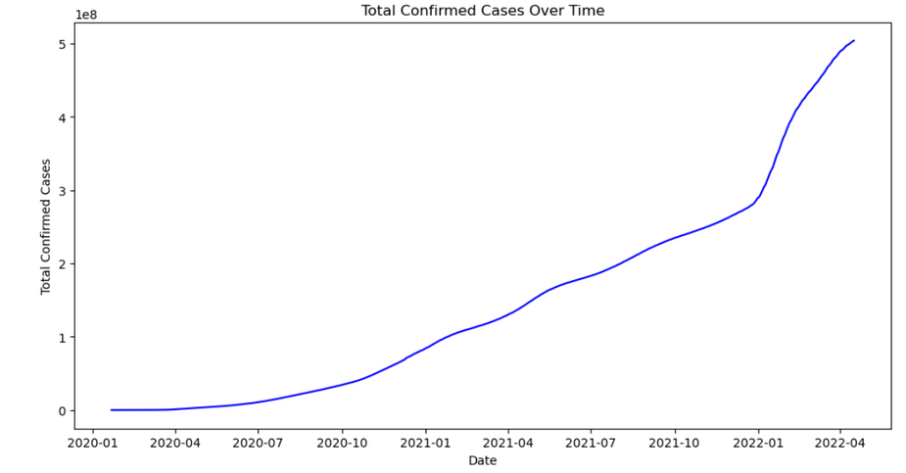
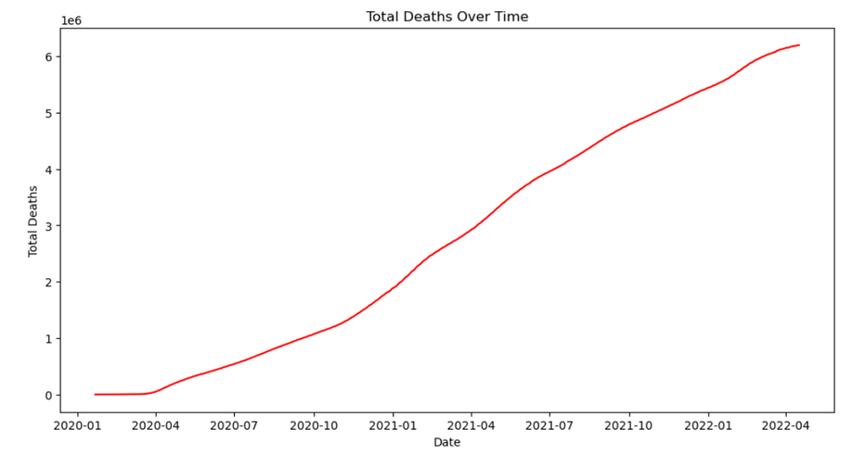
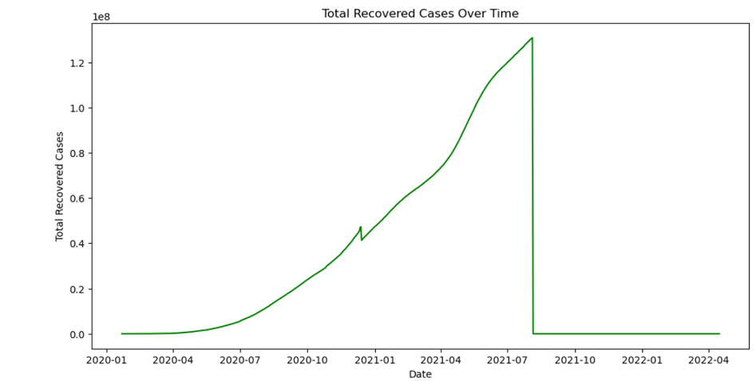
GLOBAL TRENDS

Slide 6
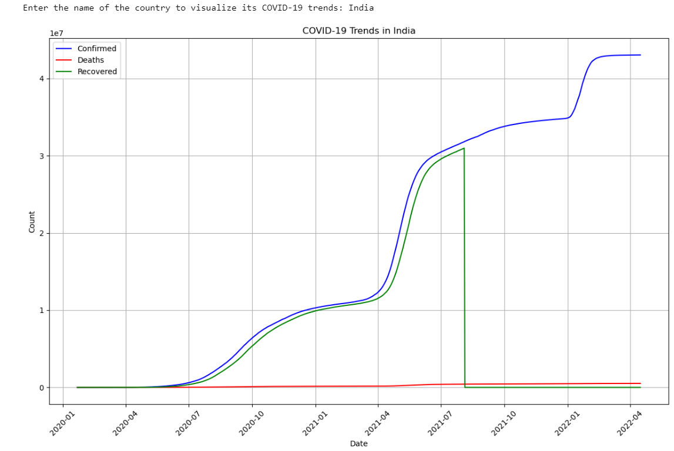
COUNTRY SPECIFIC ANALYSIS

Slide 7
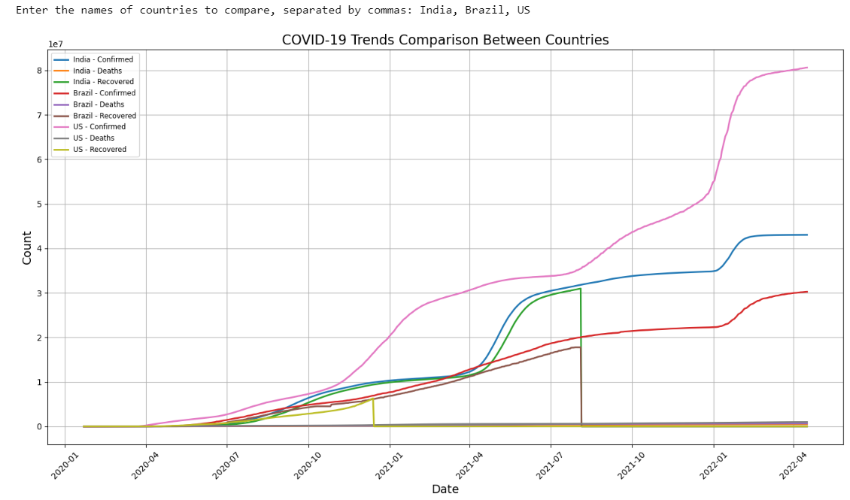
MULTIPLE COUNTRY ANALYSIS

Slide 8
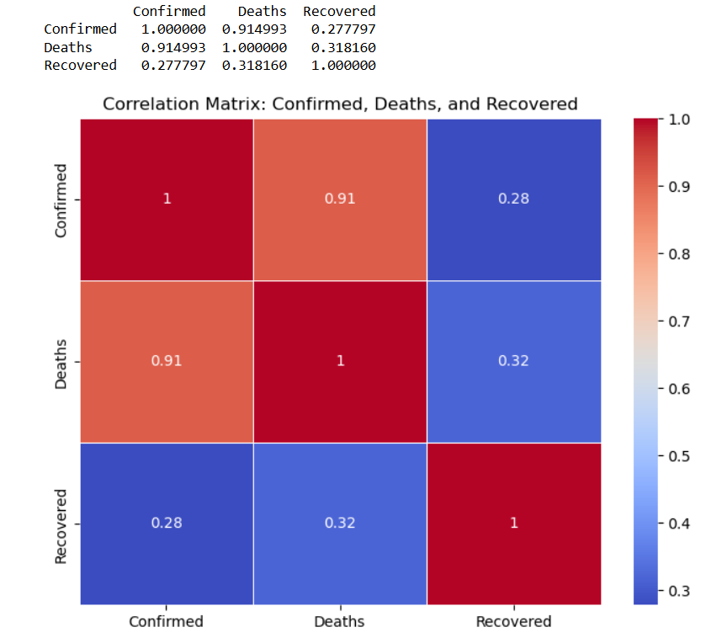
CORRELATION MATRIX

Slide 9
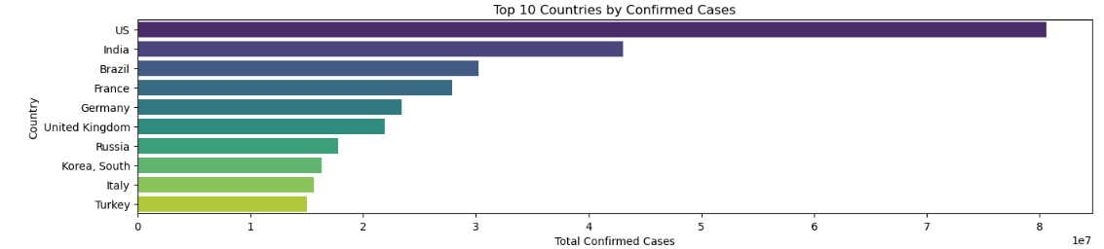
COMPARATIVE ANALYSIS

Slide 10
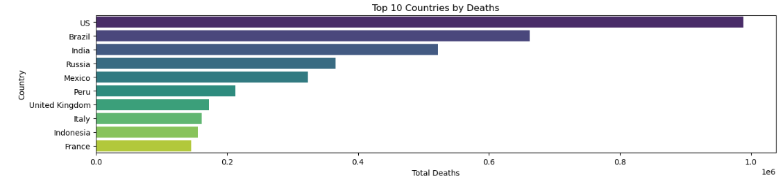
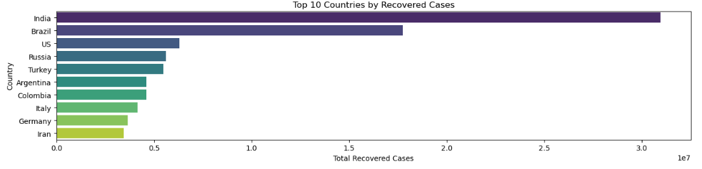

Slide 11
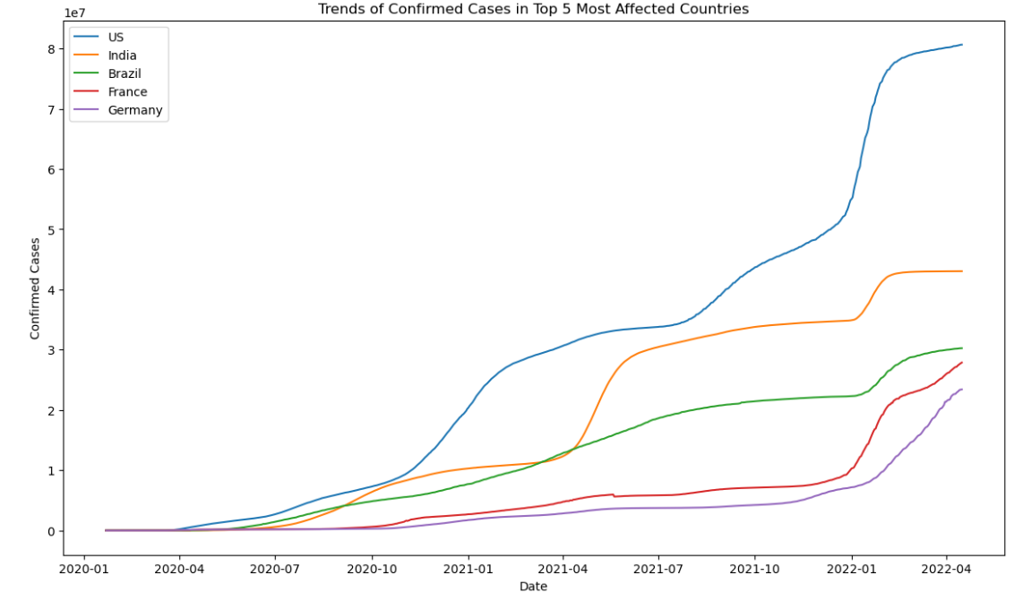
CONFIRMED CASES TRENDS

Slide 12
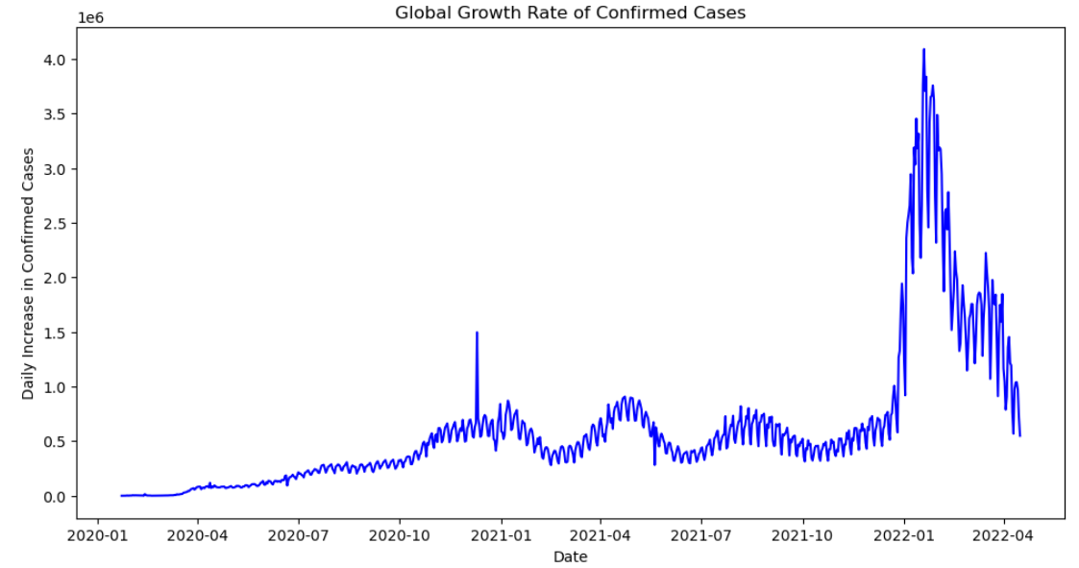
GLOBAL GROWTH RATE

Slide 13
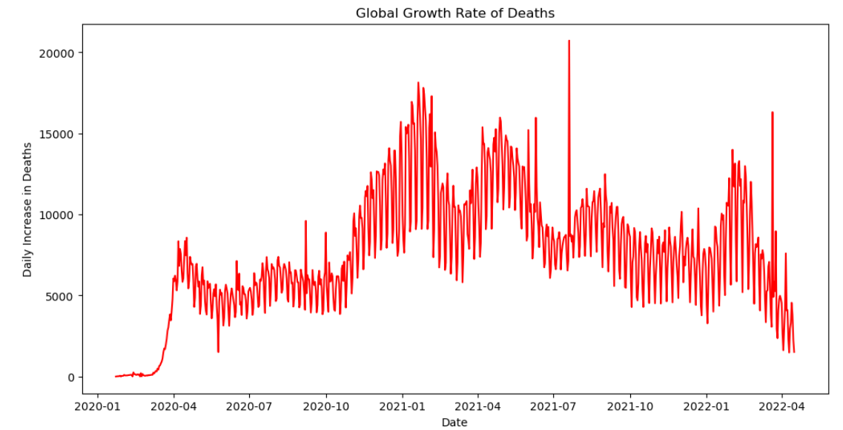
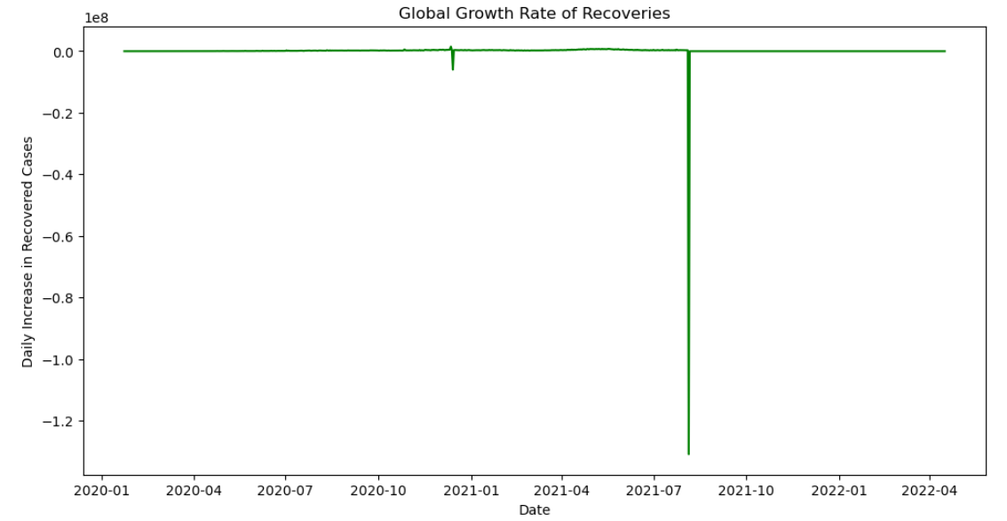

Slide 14
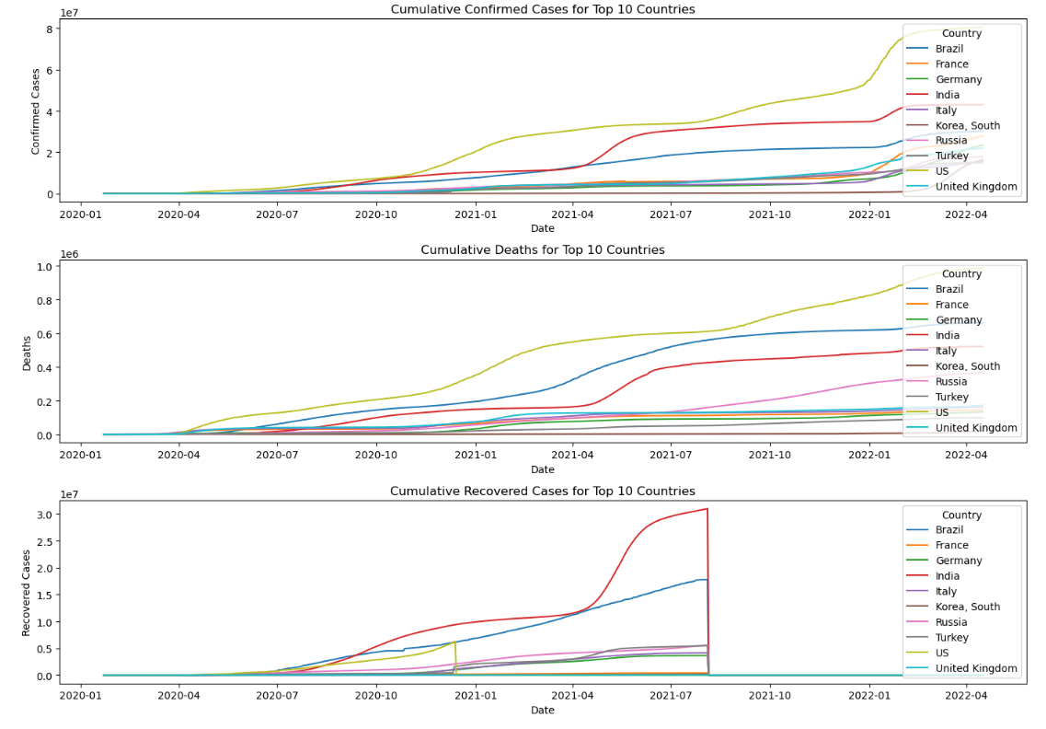
CUMMULATIVE STATISTICS

Slide 15
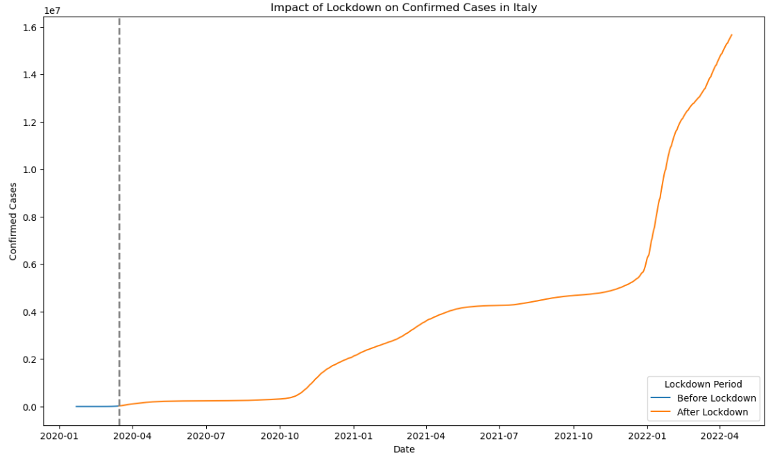
LOCKDOWN IMPACT

Slide 16
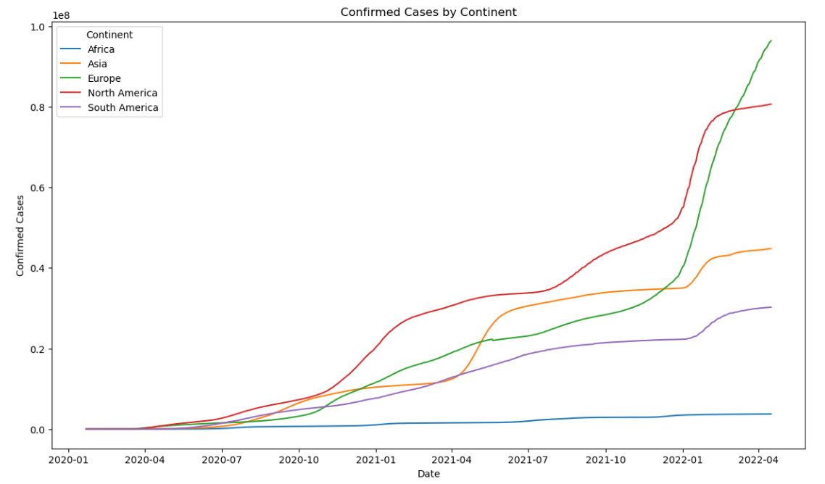
CONTINENTAL DISTRIBUTION

Slide 17
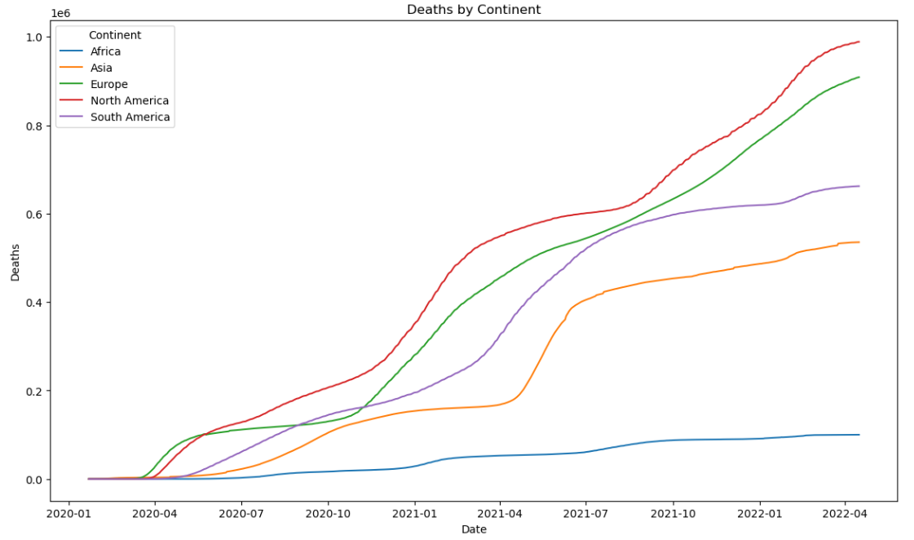
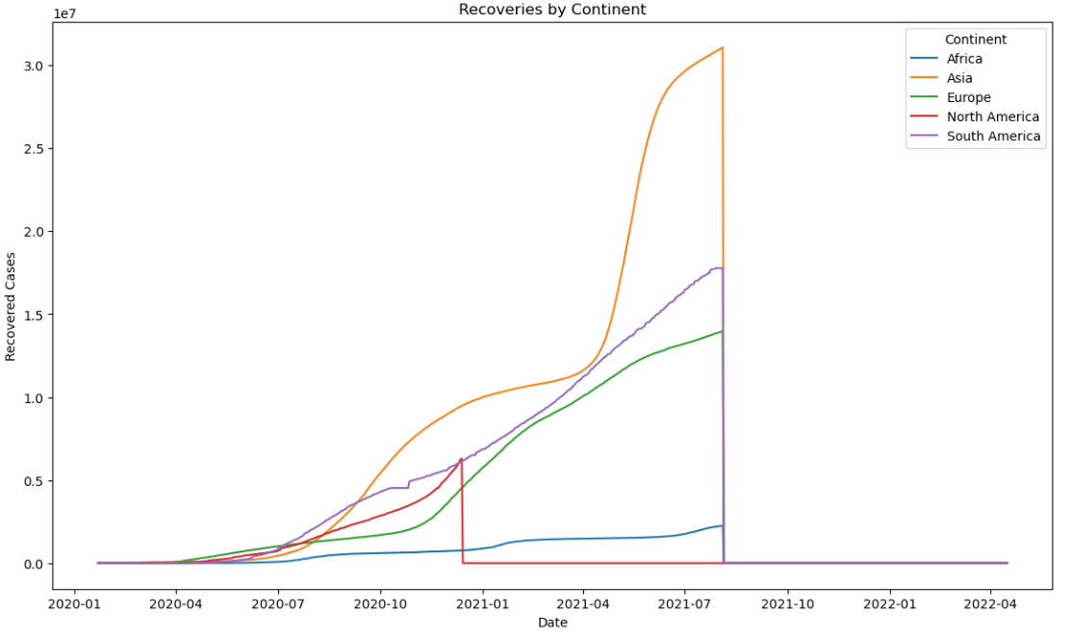

Slide 18
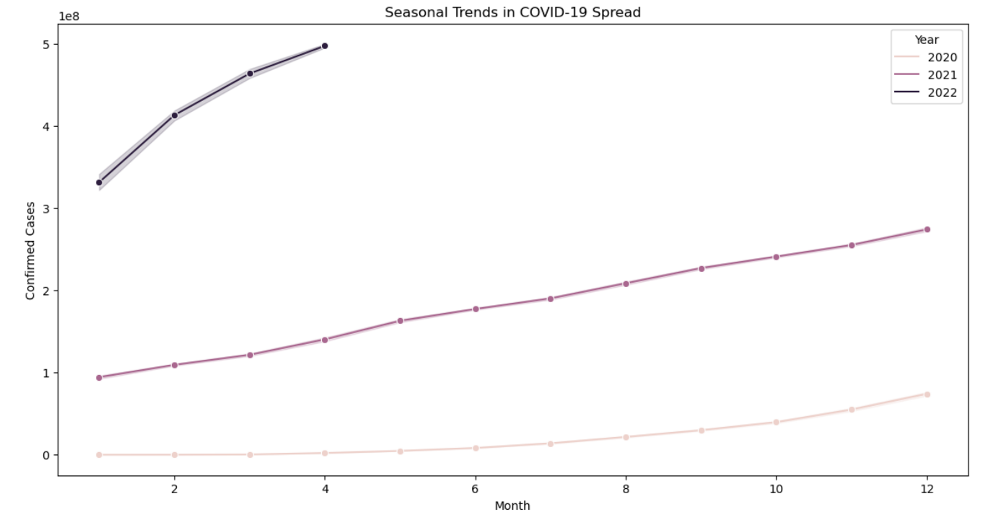
Seasonal Trends in COVID-19 Spread

Slide 19

THANK YOU

